Slide 1

Review Food
The DVK

Slide 2

About DVK
Hà Thị Phương Thảo - SE161620
Bùi Thanh Tâm - SE161754
Hồ Như Ngọc - SE161750
Nguyễn Thị Minh Nguyệt - SE161788
Trần Thị Kim Ngân - SE161483

Slide 3
Table of Content
Introduction
Background
Executive summary
Proposal
Market analysis
Benefits

Slide 4
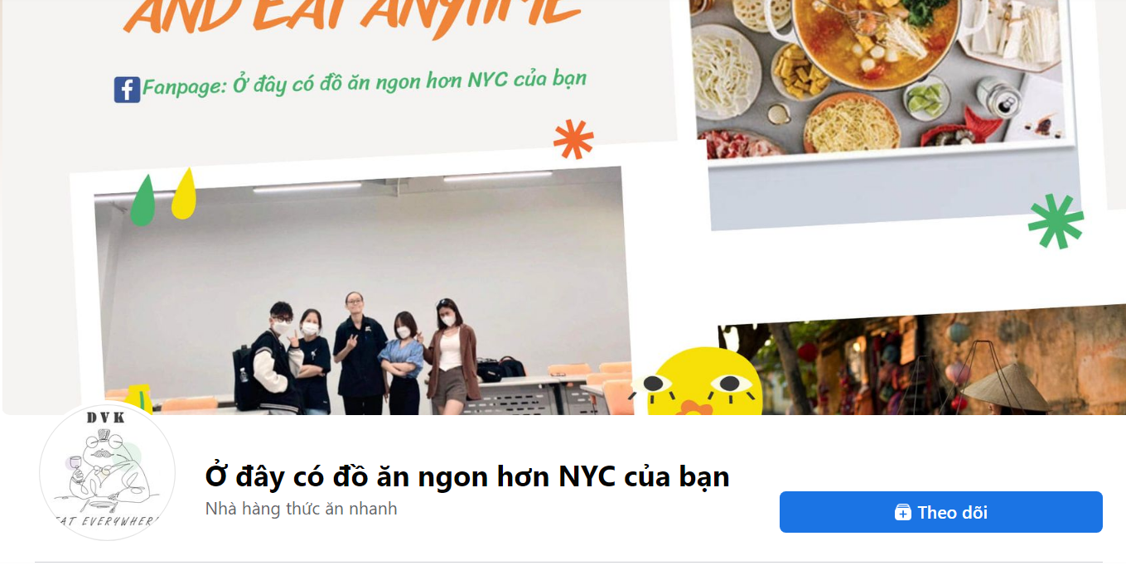
INTRODUCTION
The name of our group's page brings a sense of joy, humor, and wit to everyone when they visit our page, but the most important thing is still the best quality food and restaurants that we want to introduce to.
Looking at the cover photo and profile picture of the page, you can see that: the message of our team wants to talk about a good experience for everyone with delicious, quality food, clean hygiene, cheap but quality. Very good price suitable for students, students and weekend families can eat together after a tiring working week.

Slide 5
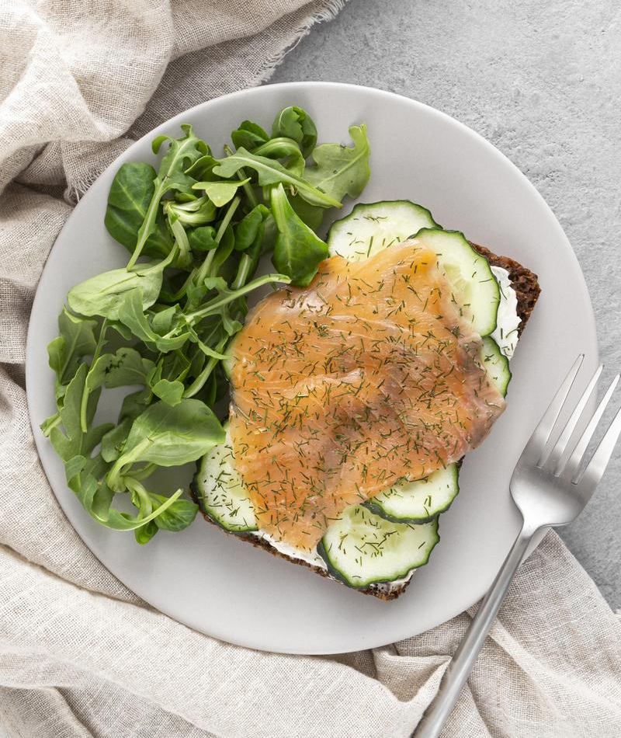
EXECUTIVE SUMMARY
And our team is coming up with ideas for a culinary project, reviewing delicious restaurants, delicious dishes for everyone to enjoy after tiring days of work and study, no time to prepare food by themselves. eat for yourself or are wondering what to eat, thinking about the reasonable price that you can spend to eat: then you can visit our page for reference, suggestions for everyone About the food, the shops are suitable for the budget but assured of the quality.

Slide 6
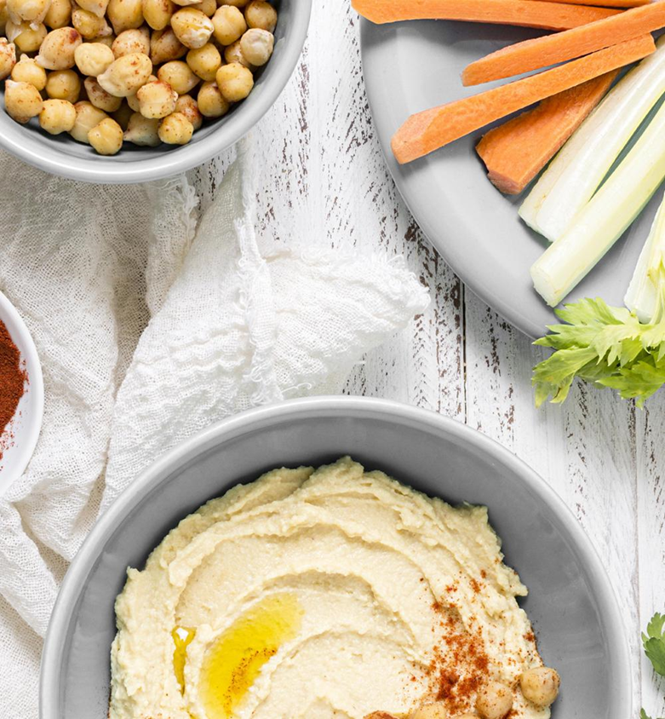
We will review for everyone in the most honest way, with the most honest feelings and comments so that everyone can be assured of the quality without having to worry about whether this restaurant is good or not?, cheap or not? Quality or not? Please rest assured that the dishes and shops we review will be the prices of students, students, the safest to spread to everyone, the addresses of good quality food with affordable prices will update all. All on the page so that you can refer to it without having to wonder: What to eat today?

Slide 7
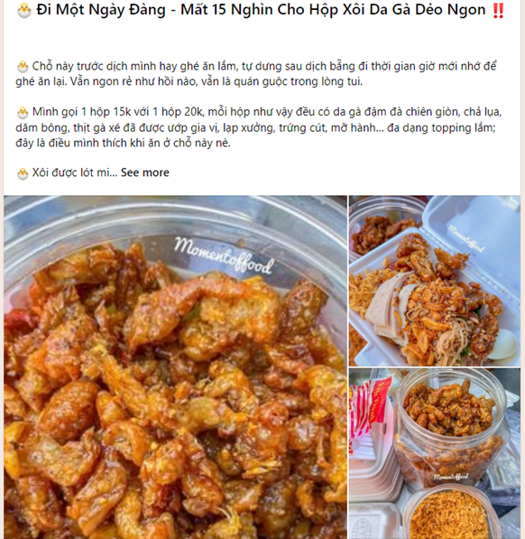
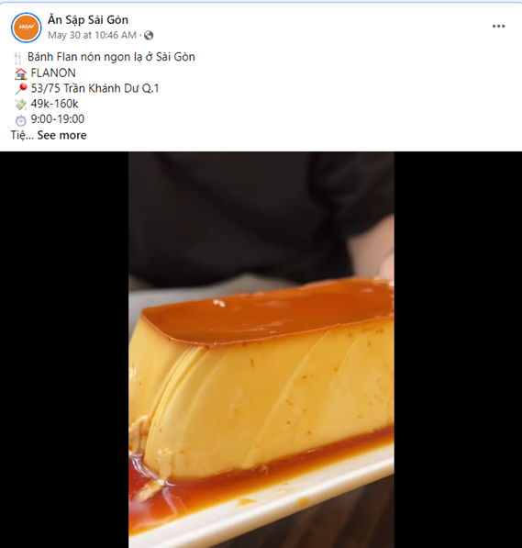
BACKGROUND
Today, social networks have become an effective tool for supporting communication and promoting products to consumers at a reasonable cost. According to a survey by iPos.vn, 32% of Facebook posts mention the F & B (Food and Beverage Service) brand. Brand postings on social media are food inspiration for 19% of users. Therefore, the social network Facebook has a huge impact on the dietary decisions of all families. Meanwhile, they look and share articles about real sounds to relieve stress and find joy.

Slide 8
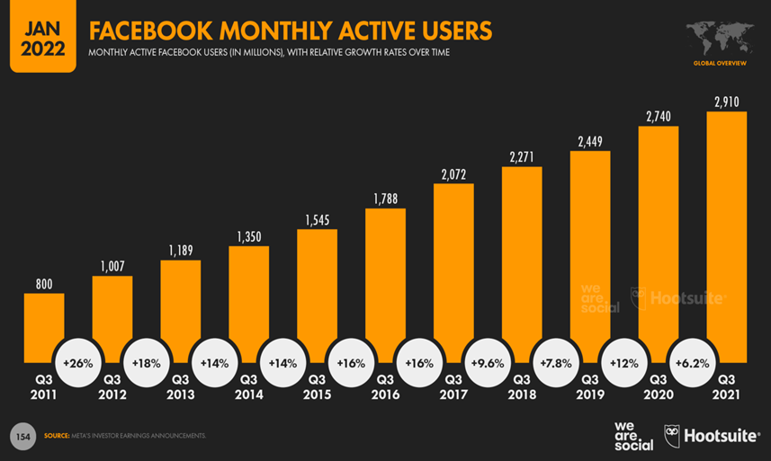
Facebook has two popular ad formats. Video created by food bloggers. The numbers show that 79% of customers trust food blogs and bloggers with many followers. Four times more than any other industry. Referrals, praises, or phone calls from this audience have a far greater impact on consumer behavior than advertising alone. The second is that food review articles that include eye-catching images, POS addresses, and prices for each dish are preferred by many, highly interacting, and easy for consumers to choose.

Slide 9

PROPOSAL
Nowadays, food review is no longer a strange thing on the internet, thanks to articles about culinary experiences and reviews, people can find a delicious and luxurious restaurant worth enjoying. People can know unique restaurants with prices ranging from affordable to high-end without necessarily having tried them. People who read the reviewed articles then choose where they want to eat and that's what our site wants to deliver.
Specifically, our page gives you the most honest look, it talks about the places of the restaurant, the food is worth you to enjoy, conveys your sense of taste and shares the address. so you can come and enjoy.
If you are wondering what to eat and where to eat, you can refer to the review articles from our site. We will give you all information about the dish such as: Name, color, taste, service of the restaurant, dining experience, address of the restaurant and price for your reference and choice. choose

Slide 10

- Our target audience is everyone. - Anywhere and any time. - We want everyone to be able to know good places to eat because now we have a high demand for food, we like to eat well, enjoy, not just eat to live.

Slide 11
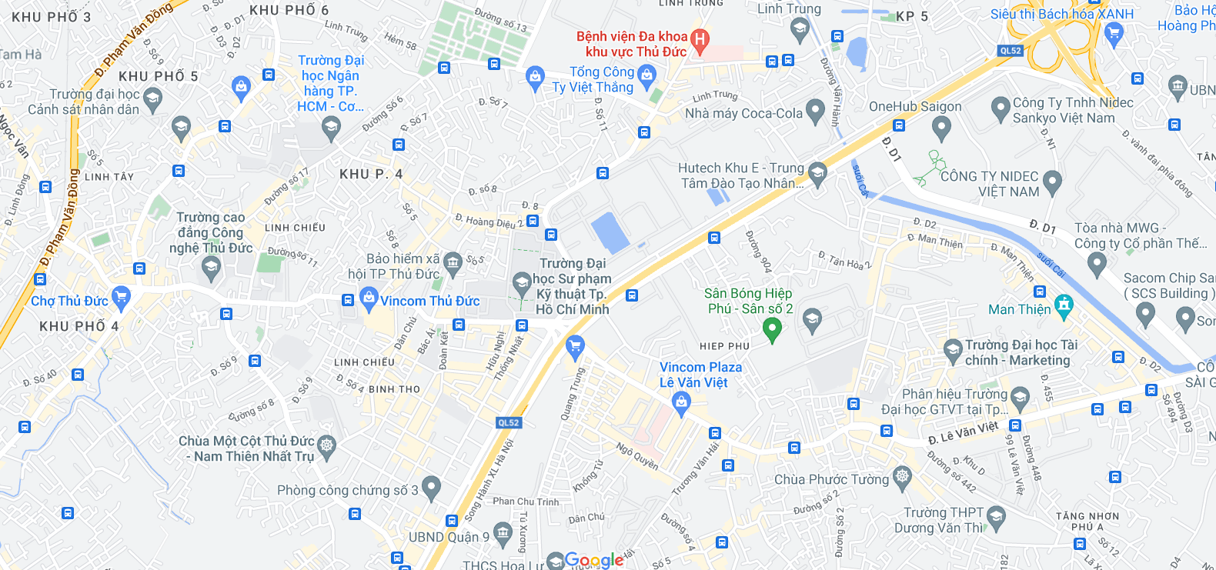
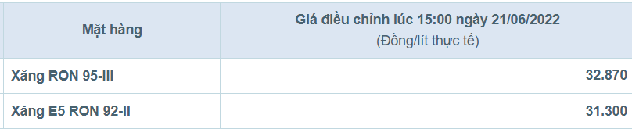
MARKET ANALYSIS
Now on Facebook, there are many food review sites, but most of them are other addresses with very few places in Thu Duc. Going too far makes it very difficult to gather together, and now the price of gas has increased, which is extremely inconvenient. So our group will find delicious and cheap student restaurants in Thu Duc to review for you. After school, we can meet friends to eat, do group exercises easily without having to go far. We will go to every nook and cranny to bring everyone quality meals, we will eat them all to find the bestsellers to recommend to everyone.

Slide 12
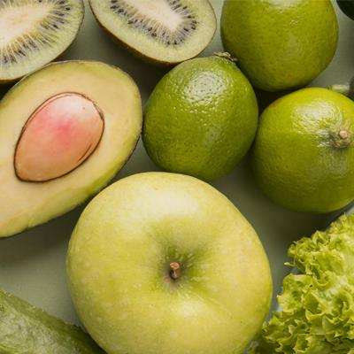

BENIFIT
Immediate benefits
Long term benefits

Slide 13
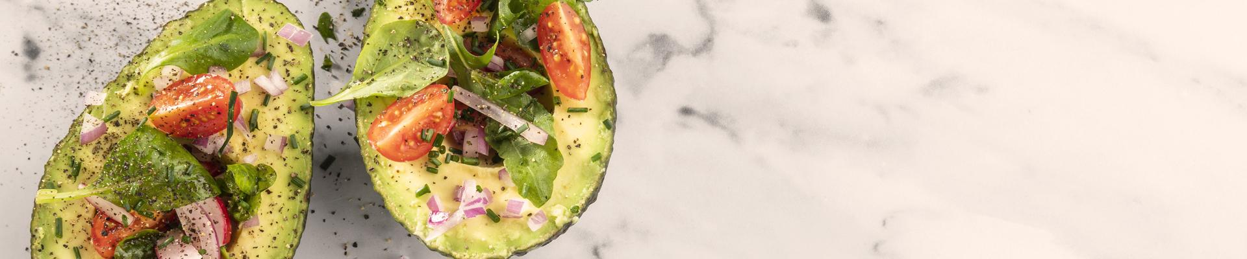
Immediate benefits
- Reviews help readers easily look up information through keywords or hashtags about dishes, locations, names of restaurants and cafes, making the process of refering to information about restaurants more convenient.
-The advantage of product reviews is to hit emotions strongly. Capturing customer psychology, reviewers put themselves in the position of customers to meet their needs and desires.
- Food review is authentic and natural, does not make customers feel uncomfortable like other advertising methods that follow them anywhere

Slide 14

Long term benefits
- Food reviews help customers have an overview of the products/services of the restaurant or cafe. Among hundreds of restaurants and cafes, customers want an advice from friends or a review from the online community so they can make the right decision. They look for reviews on the page, simply, they want to know: is the food there good, is the service good? Is the restaurant clean, ensuring food hygiene and safety? Is the price suitable?
- Reviews help customers find their favorite restaurants, tastes, and preferences. Unlike any other advertising methods, reviews bring absolute trust to customers.
- When customers feel that their review is of good quality, when they are wondering about which restaurants or they are looking for a new dish, they will find their page and bring positive reviews. great for the page, help the page spread more to everyone

Slide 15


TIMELINE
Week 1 - 2
Week 3 - 5
Week 6 - 10
Page establishment, create idea.
Basic details: share food, share address, review
Posting Page.

Slide 16
Week | No. | Work | Who | Deadline | Note
1-2 | 1 | Dicuss idea project | All of team | 3/6 | Logo, logan, direction projection,…..
 | 2 | Create Logo | Ngọc | 6/6 | Change 7/6
 | 3 | Building page on Facebook | Tâm and Nguyệt | 8/6
 | 4 | Proposal | All of team | 27/6
3-5 | 5 | Sustentive page | All of team | …..
 | 6 | First post - Page introduction - Explain and purpose | Nguyệt and Tâm | 8/6 | Create an image for the intro, include the name of the page's slogan, and post it on the page.
 | 7 | Post1:#bundau | Tâm | 22/6 | Time, price, address, review food.
 | 8 | Post2:#banhtrang | Thảo | 23/6 | Time, price, address, review food.
 | 9 | Post3:#chequan9 | Ngân | 24/6 | Time, price, address, review food.
 | 10 | Post4:#chethuduc | Ngọc | 25/6 | Time, price, address, review food.

Slide 17
Week | No | Work | Who | Deadline | Note
 | 11 | Post5:#bunbo | Ngọc | 30/6 | Time, price, address, review food.
6 - 9 | 12 | Post6:#banhcuon | Tâm | 10/7 | Time, price, address, review food.
 | 13 | Post7:#banhcanhcua | Thảo | 13/7 | Time, price, address, review food.
 | 14 | Post8:#oc | Nguyệt | 16/7 | Time, price, address, review food.
 | 15 | Post9:#banhxeo | Ngân | 19/7 | Time, price, address, review food.
 | 16 | Post10:#comga | Tâm | 21/7 | Time, price, address, review food.
 | 17 | Post11:#banhmi | Ngọc | 25/7 | Time, price, address, review food.
 | 18 | Post12:#xoi | Ngân | 28/7 | Time, price, address, review food.
 | 19 | Post13:#bone | Thảo | 30/7 | Time, price, address, review food.
 | 20 | Post14:#banhcan | Nguyệt | 2/8 | Time, price, address, review food.
 | 21 | Post15:#quannhau | All of member | 7/8 | Time, price, address, review food.

Slide 18

Thank You
“Dít vừa khít, dít đủ no”.

